Slide 1



Bank CRM Analysis
Tools Used: SQL | Power BI | Power Query | DAX
Presented by : Souparna Maity
November-2025

Slide 2

Agenda
01
Problem Statement
02
Data Overview (Schema)
03
Metrics and their Insights
04
Dashboard
05
Recommended Actions
06
Conclusion
07
Recommendations

Slide 3


Introduction
Introduction
01
Welcome to the presentation on customer relationship management in the banking sector. As the analytical CRM specialist for the bank, I've been tasked with extracting insights from diverse customer datasets to reduce churn, improve service, and boost satisfaction.
Throughout this session, we'll explore customer demographics, transaction details, exit records, and active profiles. Our goal? To uncover valuable insights that drive strategic decisions and foster lasting customer relationships.
Let's dive in and unlock the power of data-driven strategies for customer retention and satisfaction.

Slide 4

Problem Statement
02
You are an analytical CRM (Customer Relationship Management) specialist hired by a bank to extract meaningful insights from various customer-related datasets. The bank aims to reduce customer churn, improve service delivery, and enhance customer satisfaction. They have provided you with datasets including customer demographics, transaction details, customer exit information, and active customer profiles.

Slide 5
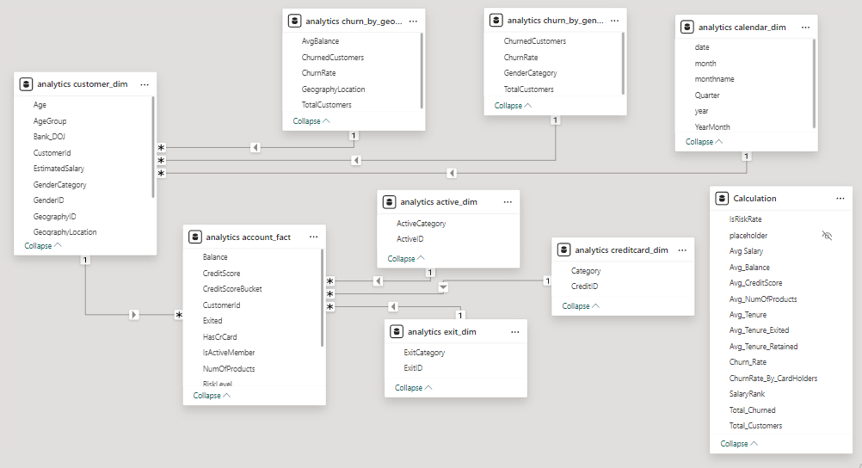
Data Overview (Schema)
03

Slide 6
Executive KPIs
Overall churn ~20% with engagement & tenure as key drivers
Avg. Balance
Total Customer
Churn Rate
20.37%
$76.49k
10,000
Total Churned
Avg. Tenure
Active Customer
2037
4.86
10,000

Slide 7
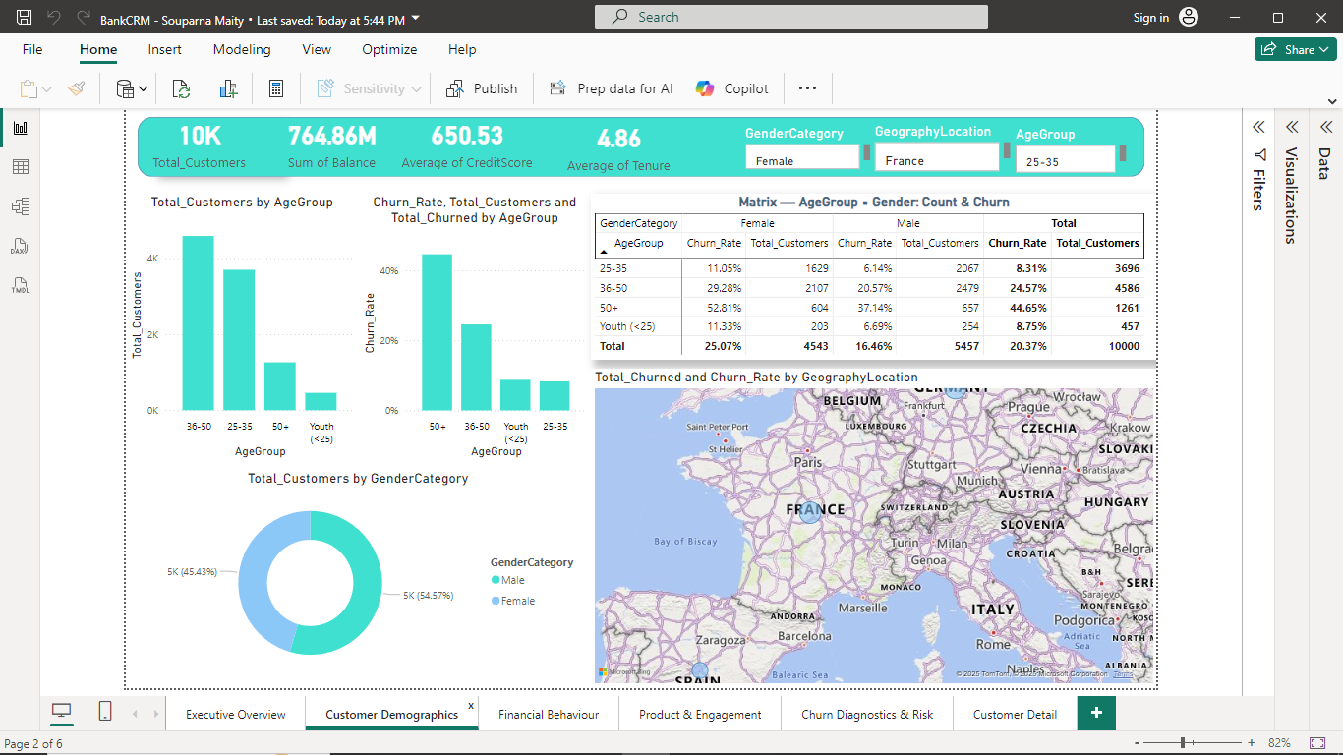
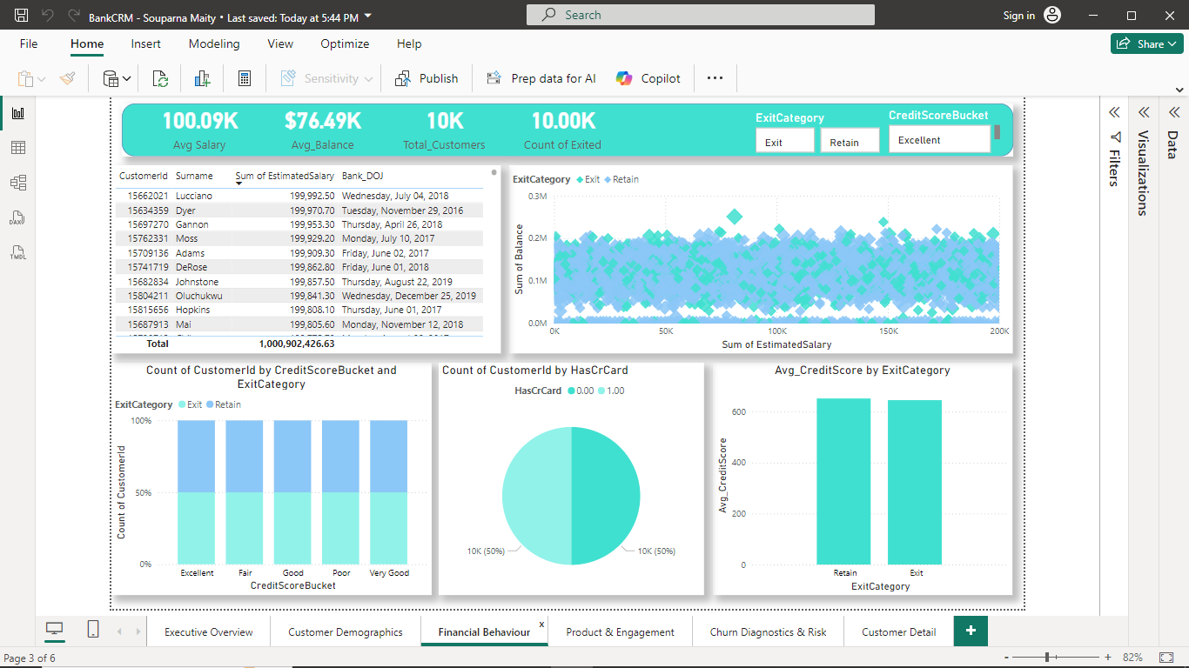
Customer Landscape
Executive Insights
Average age ~38-40 Core customer base is mid-career professionals — peak earning and borrowing years.
Balanced gender split Customer portfolio is gender-neutral, indicating broad appeal and equal acquisition success across segments.
Strong geographic skew toward France France > Germany > Spain in customer share Suggests market maturity and deeper penetration in France, while Spain remains under-leveraged with higher churn risk.
Mid-career, stable earners in France form the bank’s strategic core segment.
Recommendation
Prioritize mid-career segment with targeted value expansion
Actions
Offer salary-linked financial planning (wealth, insurance, investments)
Loyalty rewards for multi-product adoption (credit + savings + loan bundle)
Premium advisory & digital-first experience for working professionals

Slide 8
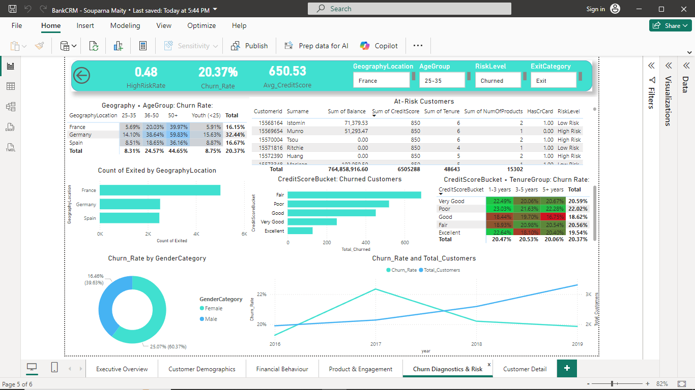
Churn by Geography
Spain shows highest churn; local interventions required
Executive Insight
Spain exhibits the highest customer churn, materially higher than France and Germany. This suggests region-specific frictions, likely driven by service gaps, product fit, or competitive banking alternatives in Spain.
Customers in Spain may be:
More price-sensitive or fee-sensitive
Experiencing inferior service experience
Facing stronger competitor offers
Less engaged with multi-product banking
Spain’s disproportionate churn signals the need for hyper-local retention levers and deeper voice-of-customer understanding.

Slide 9
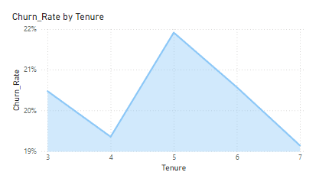
Churn by Tenure
Early-life customers most vulnerable first 24 months critical
Executive Insight
Customers exhibit the highest churn within the first 1–2 years of joining. After 24 months, churn declines significantly, indicating that relationship maturity drives stickiness.
Churn is front-loaded — early engagement determines lifetime value.
Recommendation
Design a structured 24-month onboarding & engagement playbook
Actions
Personalized welcome + advisory session in first 30 days
High-touch guidance for digital channels & product setup
Proactive communications:
Month 1: onboarding and features
Month 6: savings/credit planning
Month 12+: cross-sell wealth products
Early loyalty rewards for tenure milestones (6-12-18-24 months)
Outcome Improve early-life retention, shift customers into the loyal, multi-product segment, and reduce re-acquisition costs.

Slide 10
Churn by Credit Score
Low–mid credit score customers show highest churn — financial stress segment at risk
Executive Insight
Churn is disproportionately higher among customers with lower to mid-range credit scores (580–700). Higher-score customers maintain greater loyalty, likely due to stronger financial health and deeper banking product engagement.
Credit vulnerability = churn vulnerability
Recommendation
Deploy risk-tiered retention & financial wellness programs
Actions
Early credit-behavior alerts & personalized guidance
Credit-education nudges + budgeting tools
Targeted offers:
Secured cards / starter credit lines
Flexible payment support
Cashback/rewards tied to healthy financial behavior
Dedicated support path for financially stressed users.

Slide 11
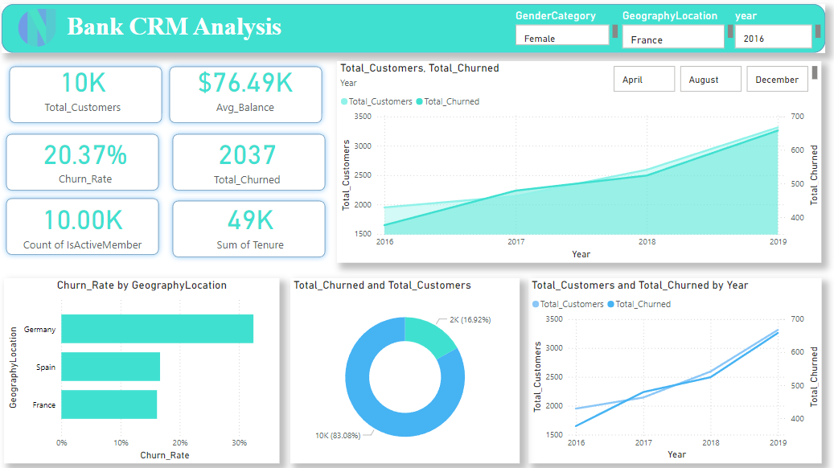
Executive Overview

Slide 12

Customer Demographics

Slide 13

Financial Behaviour

Slide 14
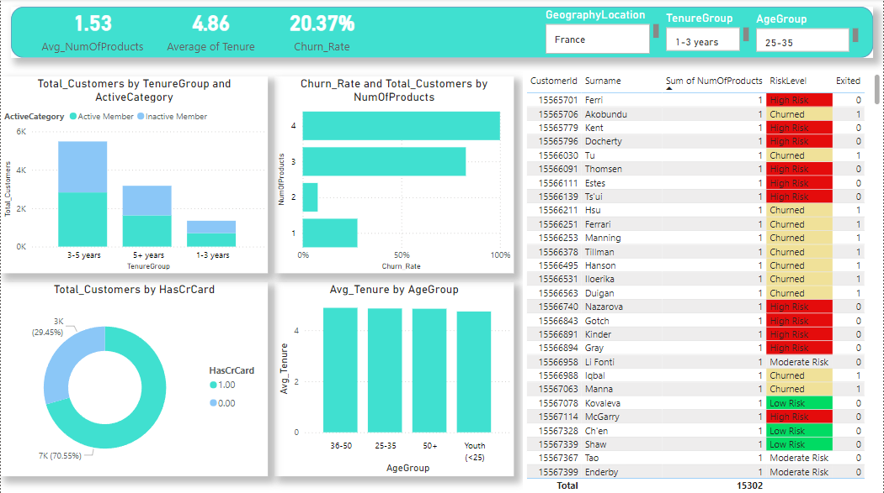
Product & Engagement

Slide 15

Churn Diagnostics & Risk

Slide 16
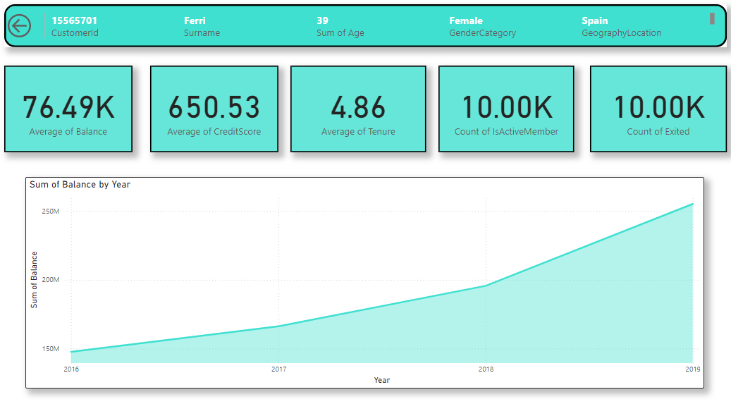
Customer Detail

Slide 17
Recommended Actions
1. Retention Program
Cashback for loyal customers
Tier-based reward memberships
2. Cross-Sell Campaign
Personal loan + credit card + savings packs
3. Engagement Boosters
EMI holiday options
Personalized wealth planners
4. Credit Support
Credit score repair advisory & alerts

Slide 18
Conclusion & Strategic Recommendations
Key Insights from the Analysis
High-Risk Segments Identified:
Females aged 50+ (52.4%) and German customers (32.4%) exhibit the highest churn rates,
signaling an urgent need for targeted retention programs.
These segments may be affected by service gaps, product mismatches, or insufficient engagement initiatives.
Low-Risk & Loyal Segments:
Young customers (18–30) and those with mid-level credit scores (670–739) show the lowest churn, reflecting stronger loyalty and stable banking behavior.
This segment represents a model profile for sustainable growth and long-term engagement.
Geographic Performance:
France demonstrates the strongest market stability, with a high customer base and the lowest churn (16.2%), making it a benchmark region for customer retention.
Spain also performs well, indicating potential for strategic expansion within European markets.
Product & Behavior Trends:
A majority of customers hold only one banking product, yet they contribute the highest overall balance, uncovering significant upsell and cross-sell potential.
Non-credit card holders (29.45%) form a large untapped group — a prime target for credit card and product adoption campaigns.
Salary shows no meaningful correlation with credit score or balance, confirming it as an unreliable predictor of churn or engagement.

Slide 19
Recommendations: Data-Driven Strategic Actions
Retention & Relationship Focus
Develop targeted retention programs for females aged 50+ and German customers,
emphasizing personalized service, proactive outreach, and satisfaction monitoring.
Offer specialized financial advice, loyalty incentives, or relationship manager touchpoints to rebuild trust and engagement.
Cross-Selling & Product Expansion
Launch personalized upsell campaigns for single-product holders and non-credit card customers.
Introduce bundled banking solutions (e.g., Savings + Credit Card + Loan) and reward customers for multi-product adoption.
Leverage Loyal Demographics
Strengthen loyalty programs and premium offers for the 30–50 male segment, which forms the largest and moderately stable customer base.
Recognize and reward tenure, engagement, and multi-product usage to reinforce retention.
Credit Score–Based Engagement
Encourage and reward mid-credit score (670–739) customers to maintain financial discipline and low churn.
For lower-score customers, provide financial education, easy-access credit products, and credit-building incentives.
Market Prioritization
Prioritize France and Spain for regional expansion and customer acquisition, leveraging their demonstrated loyalty and stable market conditions.
Implement region-specific engagement strategies for Germany to address its higher churn rate.
Data-Driven Targeting
Avoid salary-based segmentation in predictive or marketing models, as salary shows no correlation with credit or balance behavior.
Instead, prioritize tenure, product usage, credit score, and engagement metrics for customer segmentation and risk modeling.

Slide 20
Thank
You.

